Slide 1
Navy Global Aerosol and Data Assimilation Systems
Annette L. Walker
Aerosol and Radiation Section
Marine Meteorology Division
Naval Research Laboratory
Annette.Walker@nrlmry.navy.mil
(831) 656-4722, DSN 878-4722
Anthony Bucholtz James R. Campbell Cynthia A. Curtis
Edward J. Hyer Steve Lowder (SAIC) Peng Lynch (CSC)
David Peterson (NRC) Elizabeth A. Reid Jeffrey S. Reid
Juli Rubin (NRC) Walter Sessions (CSC) Douglas Westphal

Slide 2
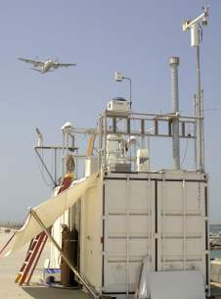
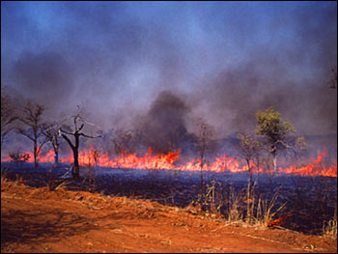
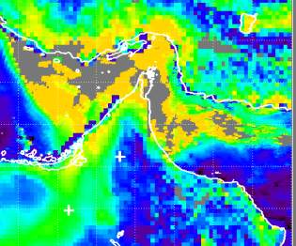
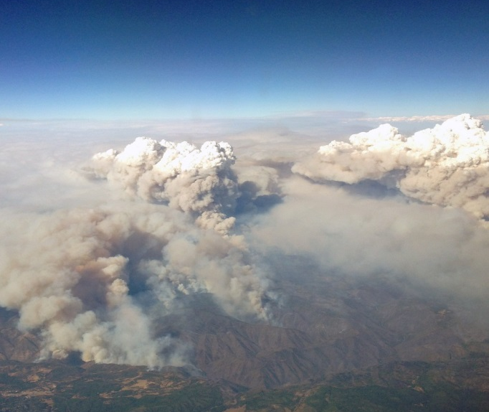
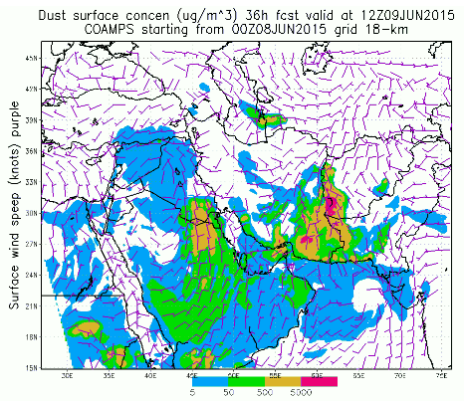
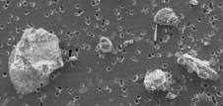
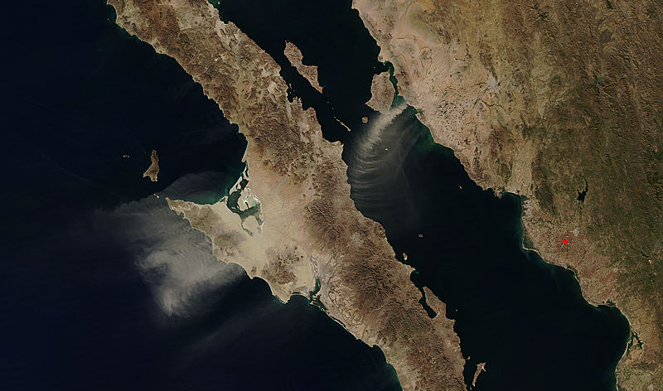
Navy Global Aerosol and Data Assimilation Systems
Radiation and lidar
measurements
Deployments
Smoke Function
Biomass burning
Data assimilation
QA/QC of Operational satellites
Study of Aerosol interactions
PyroCbs
Basic research
Dust Sources
Forecasting and Verification
Forecasting and Verification

Slide 3
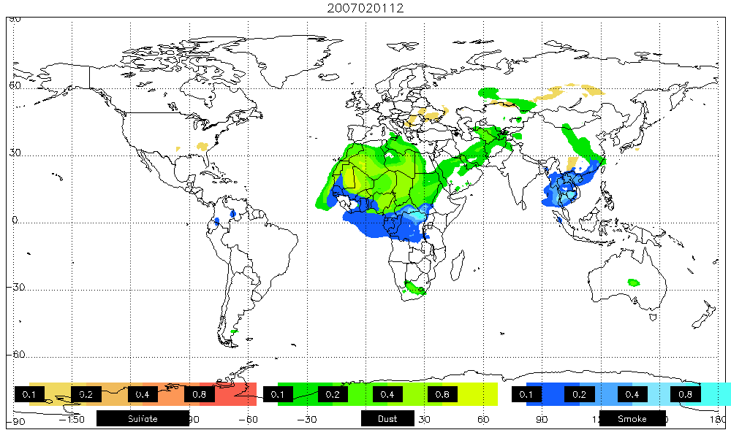
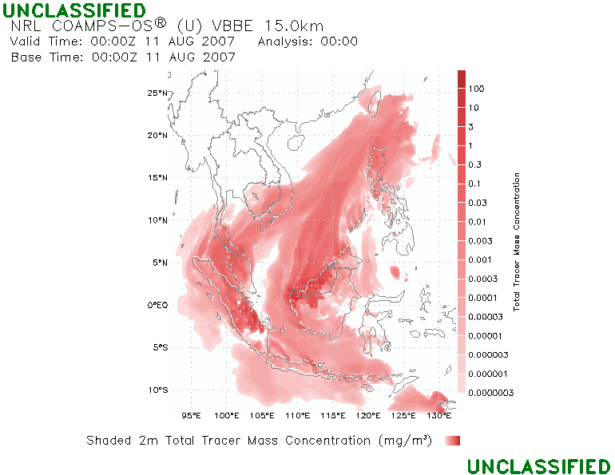
NAAPS and COAMPS
Global Modeling:
Navy Aerosol Analysis and Predication System (NAAPS)
Mesoscale Modeling:
Coupled Ocean Atmosphere Mesoscale Prediction System (COAMPS®)
World’s first operational global aerosol model and is now at 1/3 degree based on NAVGEM fields.
Utilizes world’s first operational aerosol data assimilation & fire data streams.
Forecast dust, smoke, pollution, and sea salt
COAMPS® is mesoscale model fully coupled with the ocean.
Dust forecasts operational at FNMOC since 2001 Currently adding aerosol species fully coupled with the model.
Can be used to study complicated coastal flows where aerosol particles, winds, and water vapor covary.
February 2007 Optical Depth

Slide 4
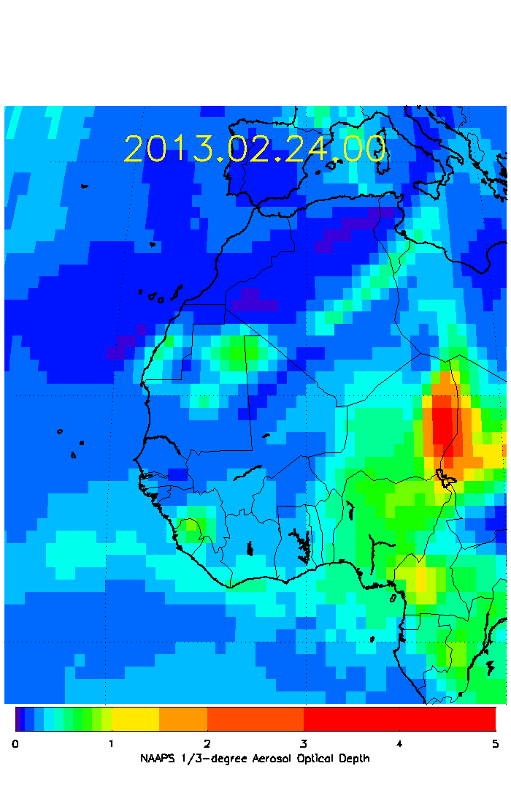
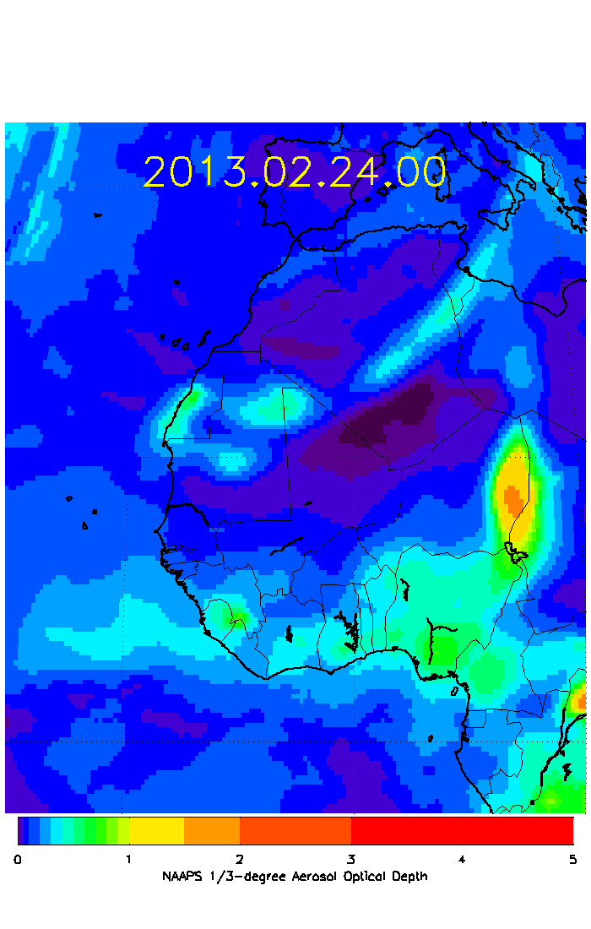
1/3° QA/QC and NAVDAS-AOD Progress
NAVDAS-AOD
Added capability for the system to use variable spatial resolution satellite data (e.g. 1°, ½°, 1/3° or 1/n resolution). Completed.
Successful cycling of 1/3° NAAPS with NAVDAS-AOD on NRL machines.
1° Res.
1/3° Res.

Slide 5
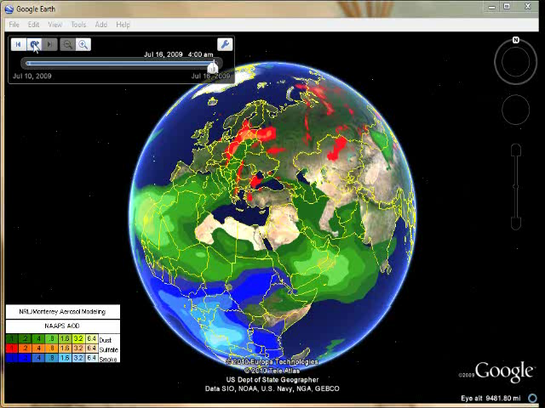
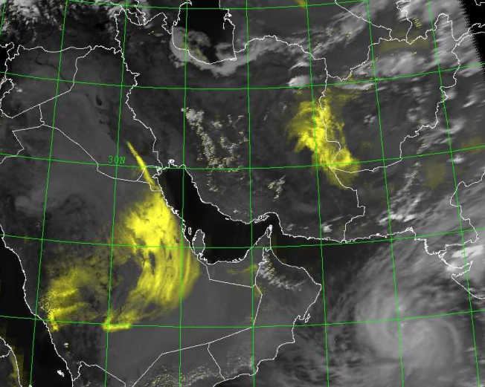
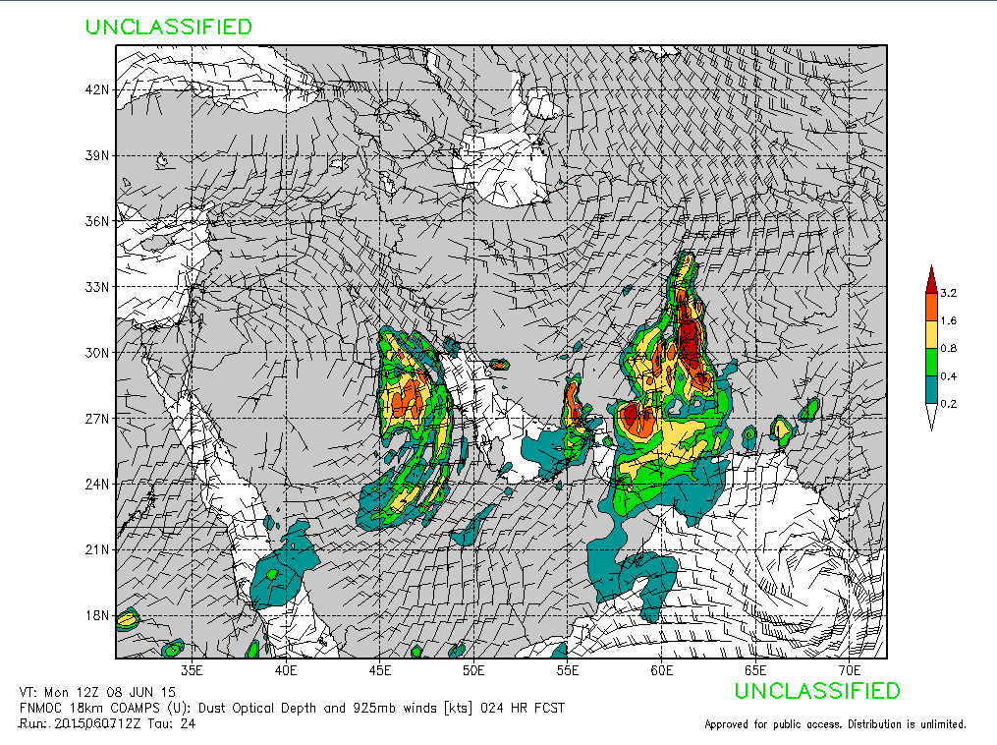
Operational Status of Models
NAAPS operational at FNMOC, 6-day forecast, four times a day
COAMPS operational for SW Asia, 3-day forecast, twice a day
  18-km SW Asia, 6-km PG, 6-km Afghanistan
FLAMBE fire detection, operational, four times a day
NAVDAS-AOD 2D-VAR Aerosol DA, operational, four times a day
FAROP operational, four times a day, derives optical properties
NRL DEBRA
20150608 12Z
COAMPS 24 hr forecast
VT 20150608 12Z
AOD and sfc winds

Slide 6
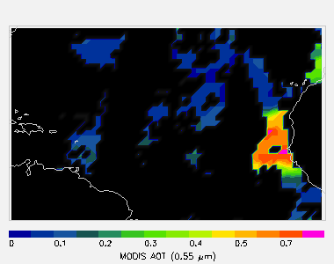
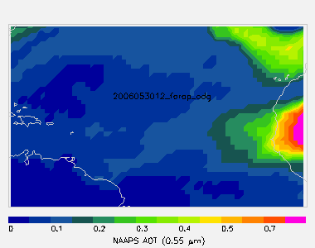
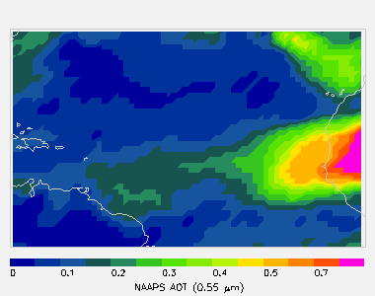
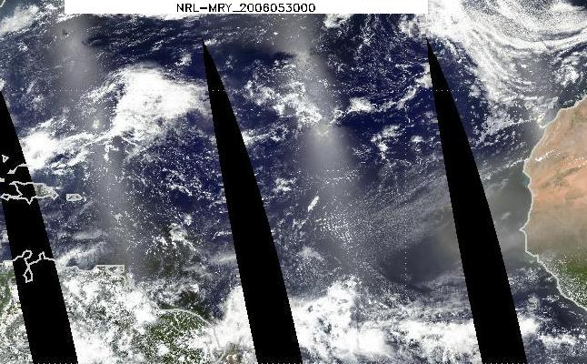
NAVDAS-AOD Data Assimilation
MODIS RGB
MODIS AOD
Produces 6-hourly, global 3-d distributions of aerosol species (sulfate, smoke, dust, salt), in real-time (and back to 2000)
Assimilated Data:
NRL Level 3 version of MODIS AOD
AERONET and CALIPSO climatology used for speciation
Operational at Navy
Coming soon: over-land AOD
CALIPSO used for 3-d var data assimilation and validation
NAAPS “Natural”
NAAPS + NAVDAS
Notes:
Jianglong Zhang led the development of an AOD data assimilation system, based on the Navy Variational Data Assimilation System NAVDAS.
The first thing I want to draw your attention to is the transformation from raw MODIS data to AOD data suitable for assimilation into the aerosol model. This process incorporates the MODIS AOD retrieval and some extra filtering and correction steps

Slide 7
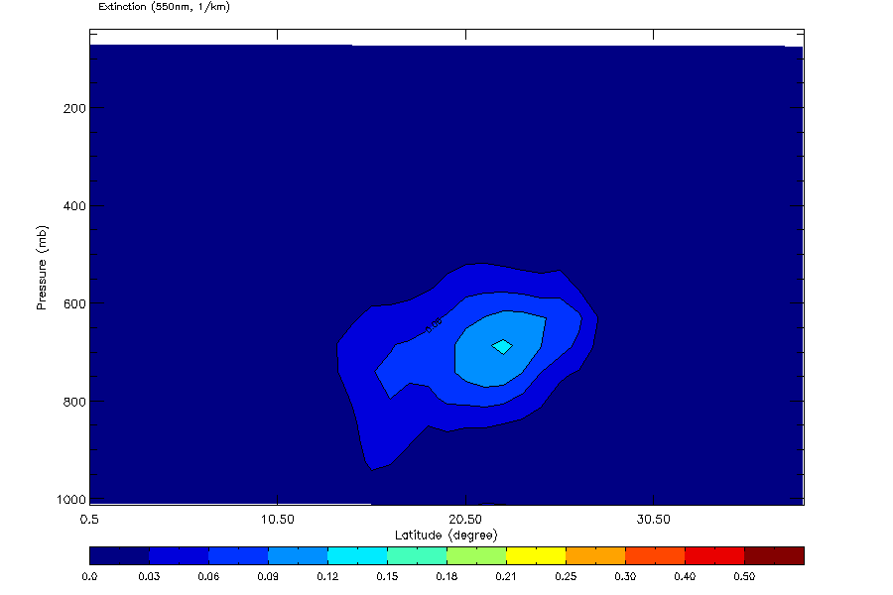
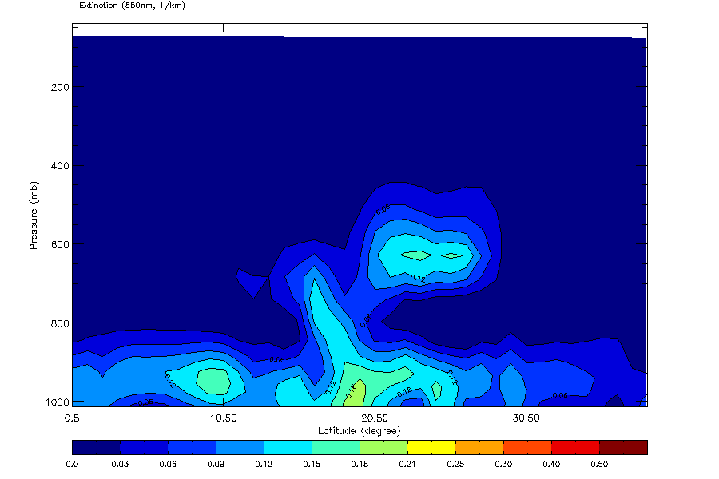
CALIPSO Assimilation
NAAPS 0.532 µm extinction profile (before assimilation, above) depicts elevated aerosol (dust) in SAL, only diffuse aerosol is noted elsewhere in profile
Processed CALIPSO data (top right) indicate substantial near-surface layer
After assimilation (right) NAAPS shows all features seen in CALIPSO

Slide 8
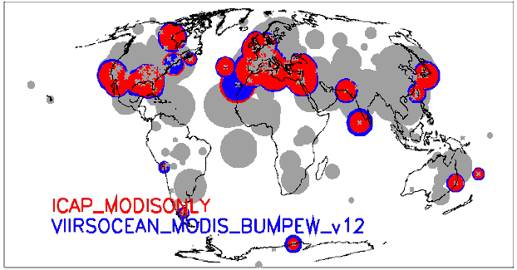
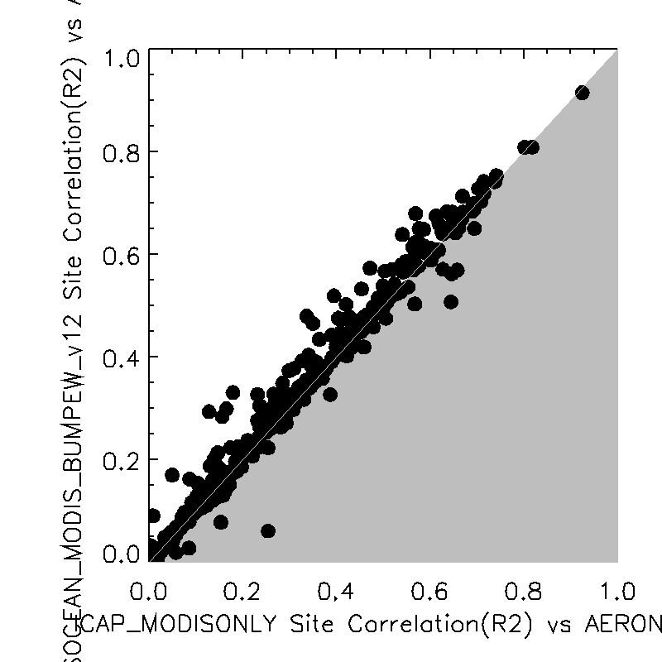
Comparison of NAAPS analyzed AOD to AERONET
NAAPS was run with the AOD assimilation package NAVDAS-AOD for the period 20130201-20140201, in two configurations:
  The first configuration was close to the current Navy operational configuration including assimilation of MODIS AOD using the NRL/UND Level 3 AOD product.
  The second configuration combined the NRL/UND MODIS AOD with a VIIRS AOD product based on the VAOOO EDR product from JPSS. This product used all in-granule quality flags as well as additional textural filtering.
Analyzed AOD output from NAAPS was compared to AERONET L1.5 observations, and statistical comparison of NAAPS vs AERONET was compiled for each AERONET station.
The balance of evidence for improvement of NAAPS analysis is based on improvement of statistical performance vs AERONET at a majority of stations. For the runs compared in this analysis, RMSE was reduced at 234 of 399 AERONET stations (not shown).
The correlation (r²) between the runs increased at 272 of 399 stations. The figures above show this as (bottom) a scatter plot of the single-station r² for each run, and (top) a map indicating the locations of stations where r² was significantly different between the two runs. Stations where r² was within 0.05 for the two runs are shown in gray; for other stations, the colors indicate the runs, and the size of symbols is proportional to the r². Thus, stations where the blue circle is larger than the red show better results for the VIIRS+MODIS run relative to MODIS-only.
EXAMPLE: Verification of VIIRS impact on NAAPS assimilation done using AERONET L1.5
LEFT: Correlation coefficient r² for each AERONET station for VIIRS+MODIS and MODIS-only. Larger = better. (gray = small/no difference).
RIGHT: scatter plot of per-station r2 of analyzed AOD.
VIIRS+MODIS has better r² at 272 of 399 stations
RMSE also tested: VIIRS+MODIS has lower RMSE at 234 of 399 stations
MODIS+VIIRS
better
R2 NAAPS w/MODIS+VIIRS
(by AERONET site)
MODIS-only
better
R2 NAAPS w/MODIS
(by AERONET site)

Slide 9
Comparison of NAAPS analyzed AOD to AERONET
NAAPS was run with the AOD assimilation package NAVDAS-AOD for the period 20130201-20140201, in two configurations:
  The first configuration was close to the current Navy operational configuration including assimilation of MODIS AOD using the NRL/UND Level 3 AOD product.
  The second configuration combined the NRL/UND MODIS AOD with a VIIRS AOD product based on the VAOOO EDR product from JPSS. This product used all in-granule quality flags as well as additional textural filtering.
Analyzed AOD output from NAAPS was compared to AERONET L1.5 observations, and statistical comparison of NAAPS vs AERONET was compiled for each AERONET station.
The balance of evidence for improvement of NAAPS analysis is based on improvement of statistical performance vs AERONET at a majority of stations. For the runs compared in this analysis, RMSE was reduced at 234 of 399 AERONET stations (not shown).
The correlation (r²) between the runs increased at 272 of 399 stations. The figures above show this as (bottom) a scatter plot of the single-station r² for each run, and (top) a map indicating the locations of stations where r² was significantly different between the two runs. Stations where r² was within 0.05 for the two runs are shown in gray; for other stations, the colors indicate the runs, and the size of symbols is proportional to the r². Thus, stations where the blue circle is larger than the red show better results for the VIIRS+MODIS run relative to MODIS-only.
EXAMPLE: Verification of VIIRS impact on NAAPS assimilation done using AERONET L1.5
LEFT: Correlation coefficient r² for each AERONET station for VIIRS+MODIS and MODIS-only. Larger = better. (gray = small/no difference).
RIGHT: scatter plot of per-station r2 of analyzed AOD.
VIIRS+MODIS has better r² at 272 of 399 stations
RMSE also tested: VIIRS+MODIS has lower RMSE at 234 of 399 stations
Take Away:
NPP VIIRS works
JPSS VIIRS will also work
Transition of MODIS+VIIRS
to operations is pending
MODIS+VIIRS
better
R2 NAAPS w/MODIS+VIIRS
(by AERONET site)
MODIS-only
better
R2 NAAPS w/MODIS
(by AERONET site)

Slide 10
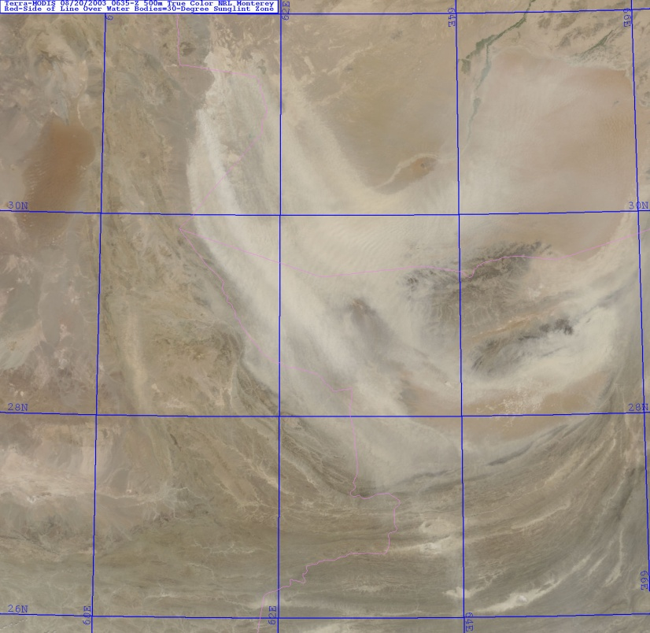
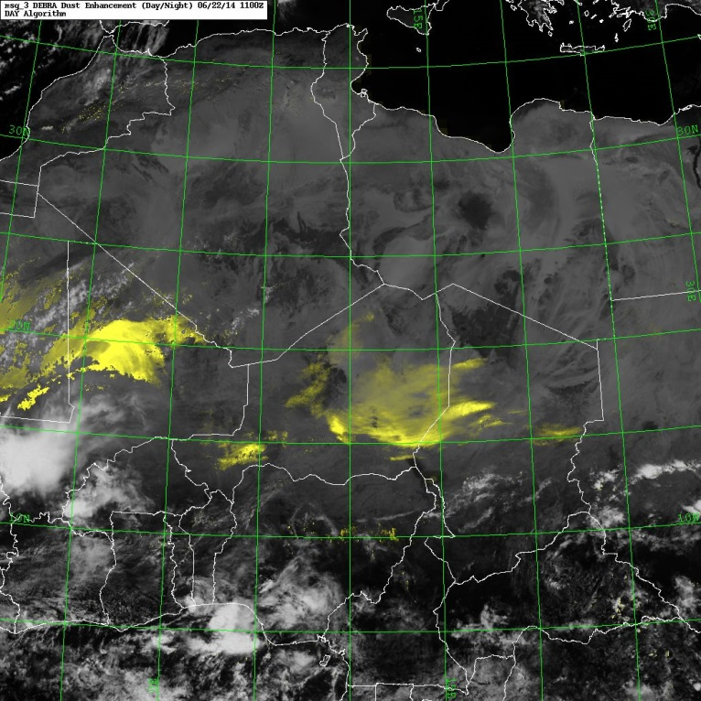
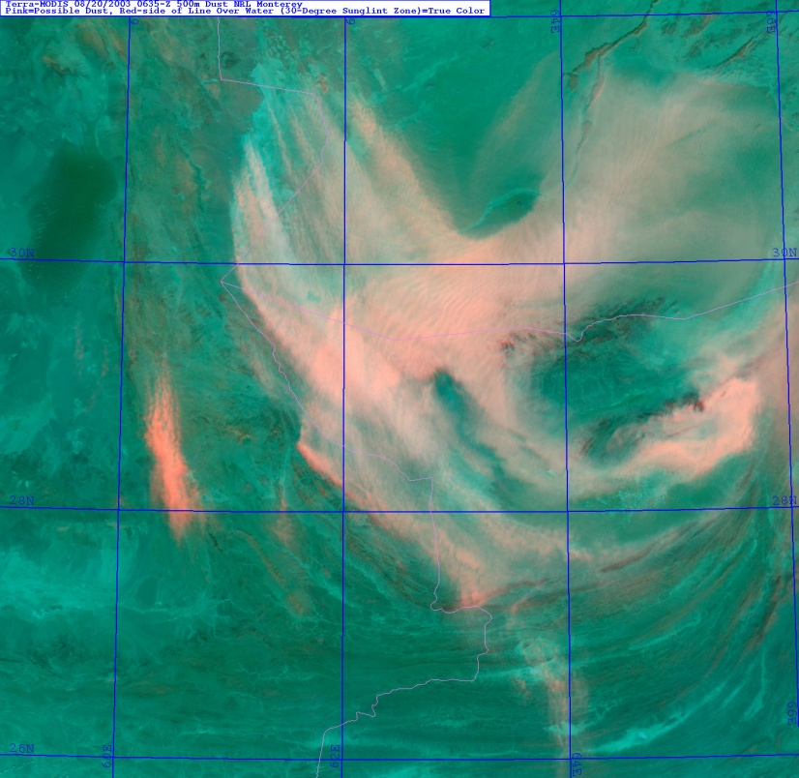
Regional Dust Source Database
High-resolution
Iran
Iran
Chad
Nigeria
Pakistan
Pakistan
20030820 NRL DEP
20030820 MODIS true color
20140622 NRL msg_DEBRA
20030820 NRL DEP
Approach and Methodology
Used 14 yrs of NRL Dust Enhancement Product (DEP) imagery (250m - 1km)
  + 5 years of NRL DEBRA Meteosat RGB product (higher temporal res. 15 min)
Dust source area entered into database
  (cursor location tool = 1km precision)
• COAMPS 10 m wind overlays
(plume head vs tail)
• Surface weather maps
(showing dust storms, reduced visibility)
• Cross-correlate land and water features
using maps, atlases, GE)

Slide 11
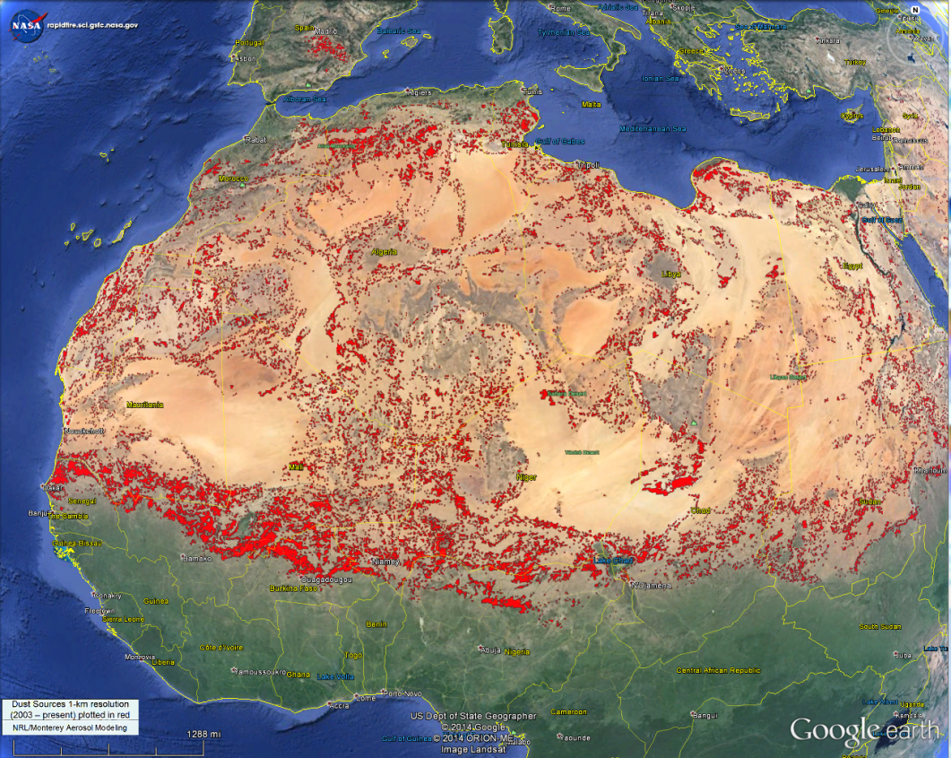
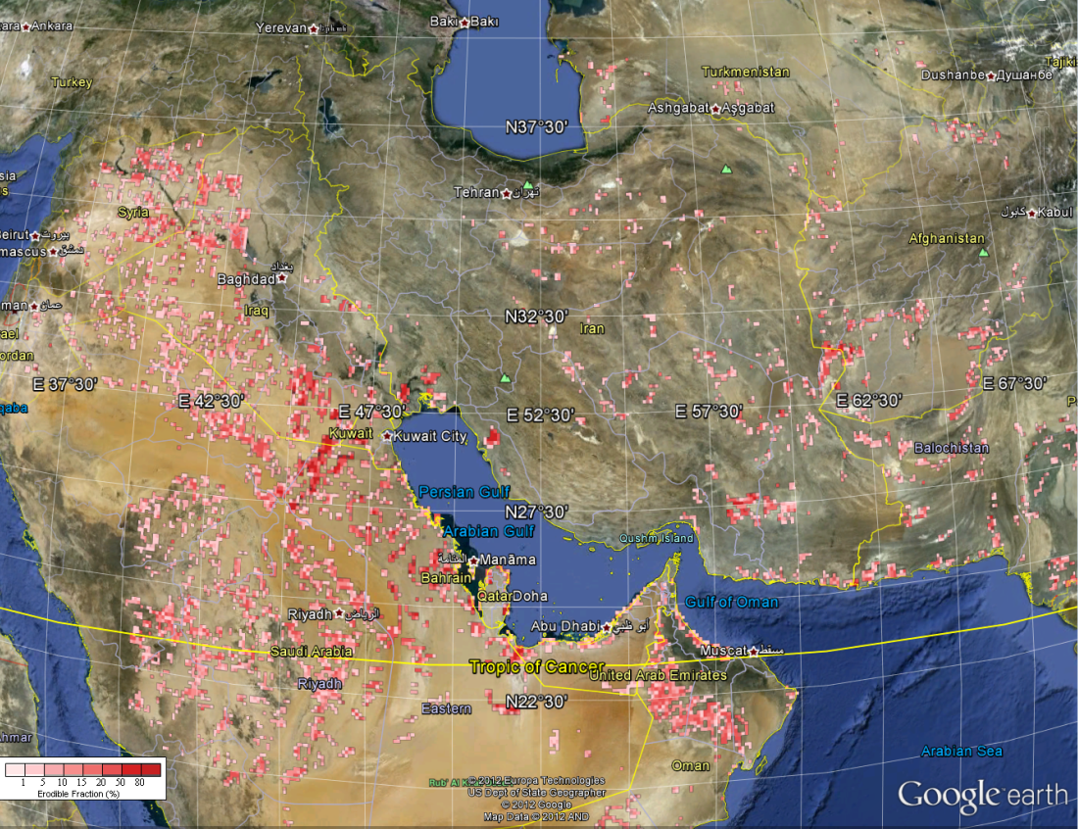
Regional Dust Source Database
High-resolution
Solid red shapes identify dust source areas located using DEP and msg_DEBRA
DSD used in COAMPS (1 km sources gridded to 6, 9, 18, 27, 54, 81 km resolution)
North Africa DSD
SW Asia DSD
Saudi Arabia

Slide 12
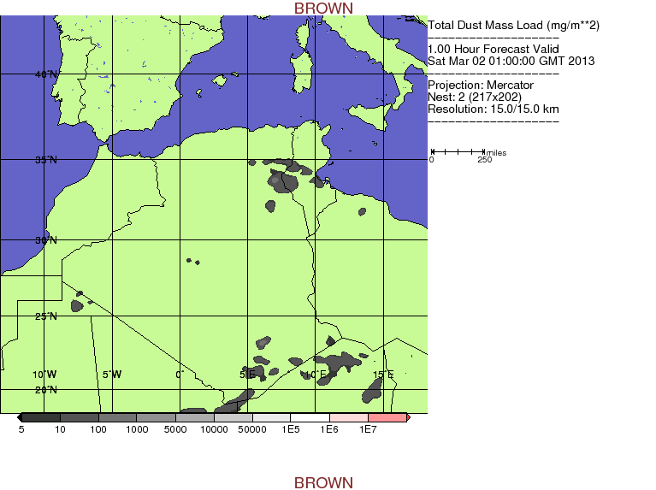
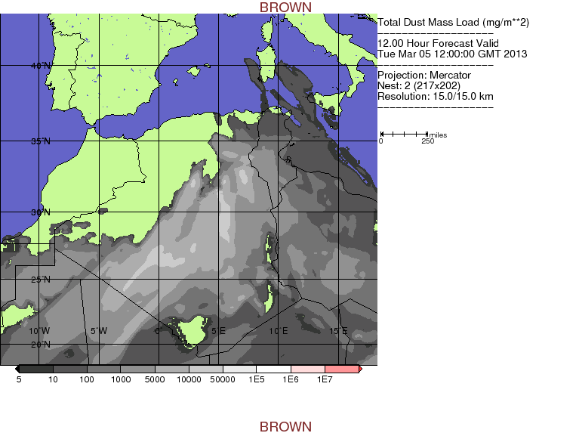
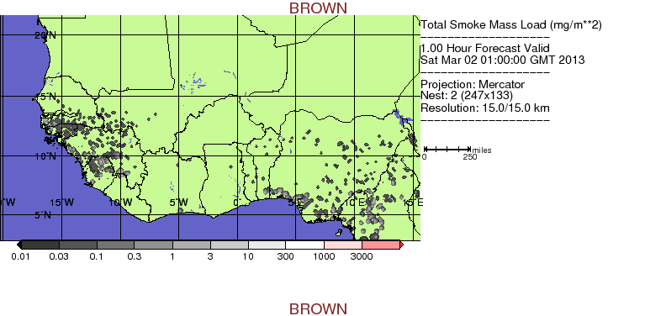
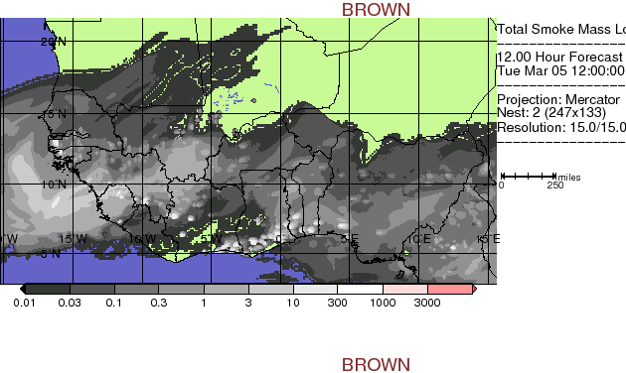
Aerosol forecasting with COAMPS
African Dust and Smoke Events
15-km COAMPS 12h forecasts of Mass Load (mg/m**2)
March 2-7, 2013 Case Study
Wind-driven dust plumes
Smoke injected from FLAMBE fires

Slide 13
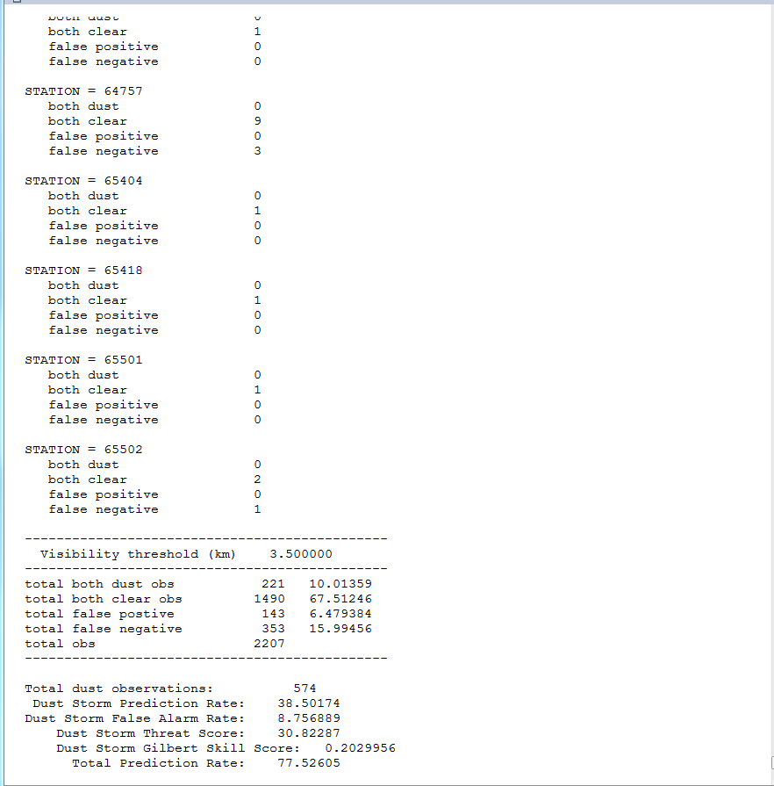
COAMPS verification of visibility
DEBRA_msg Surface Observations Output From Verification Package
March 5, 2013 March 5, 2013
Dust storm is defined as vis < 3.5 km
Compare calculated COAMPS visibility with observed weather station visibility
Approach enables calculation of statistics (DS, false alarm rate, total model skill)
Goal is to improve Navy operational capability with a new generation of cloud and aerosol products

Slide 14
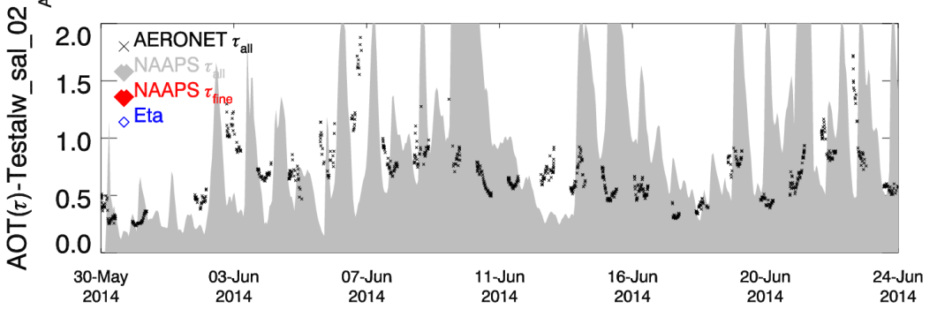
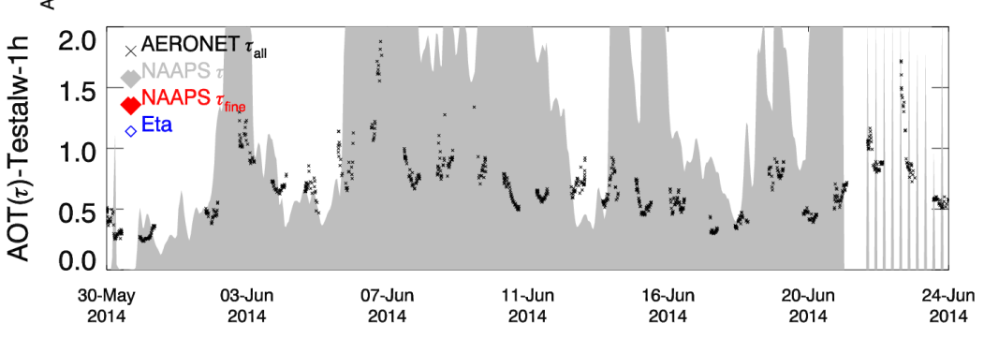
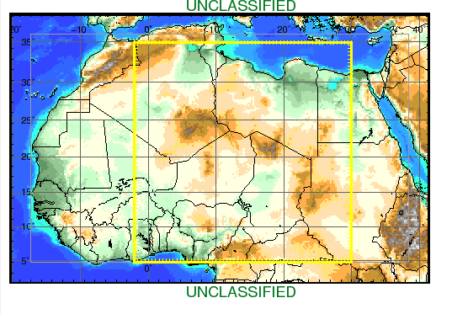
COAMPS verification of AOD
Sahara summer case study
May 30- June25, 2014
DSD
TOMS
Zinder Airport 13.78N, 8.99E
Zinder Airport 13.78N, 8.99E
COAMPS τ_{all}
COAMPS τ_{all}
  TOMS operational one-degree dust database
  COAMPS calculated AOD is compared to observed AERONET AODs
  TOMS over predicts aerosol optical depth (AOD) by 2-4 times
  AOD prediction using the NRL DSD outperform the TOMS DSD at 6 of 12 AERONET stations
Zinder Airport

Slide 15
Summary
NRL Monterey uses satellite data for :
Data assimilation
Source functions
Model verification and improvement
The NRL algorithms built for MODIS have been or
are currently being tested for NPP-VIIRS
We have successfully run NAAPS with MODIS+VIIRS DA
and have seen an improvement in modeled AODs
Since the NPP-VIIRS algorithms work
the JPSS-VIIRS algorithms will also work

